Slide 1
Unit 2- Lecture 18
Game Trees
Evaluation function

Slide 2
Game trees
The game trees are search trees with each level is a move from one of the players.
We assume a few things before proceeding further about game trees in this module.
1. Every player is allowed to play only one move in a single iteration. If he is allowed to take multiple moves in special cases, we assume a single move consisting of cumulative effects of those multiple moves.
2. There are only two players. In a typical two player game, each player owns one ply (level) at alternate level. Again, for a multiple player game, the very solution can be extended.

Slide 3
3. The games are complete information games. Thus it is possible for us to apply static evaluation function to probable moves and ascertain complete information about the board position to be used in making a decision.
4. Both opponents (players) goals are exactly opposite to each other. When one player makes a decision at one layer, next layer is second player’s prerogative. Thus, what the first player tries to maximize at one layer, the second player tries to minimize at next layer. That is why they are sometimes denoted as Max and Min layers.
As mentioned earlier a game tree contains two layers alternatively belong to one of the player.
Sometimes, Max layer is indicated by square and min layer is indicated by round nodes.

Slide 4
Sometimes Max is indicated by a triangle while min is indicated by inverse triangle .
In many cases, the nodes are not differentiated and all layers contain same type of nodes.
A game tree begins with a root node which belongs to the player who is taking a move and thus, it is a max layer.
He can choose one of the children of that ply.
An example game tree is depicted in next figure.
This game is known as tic-tac-toe and is very popular game.
This game is played by two players, one mark his move by X while the other by 0.
There is a matrix of 3 X 3 which is completely empty in the beginning.

Slide 5
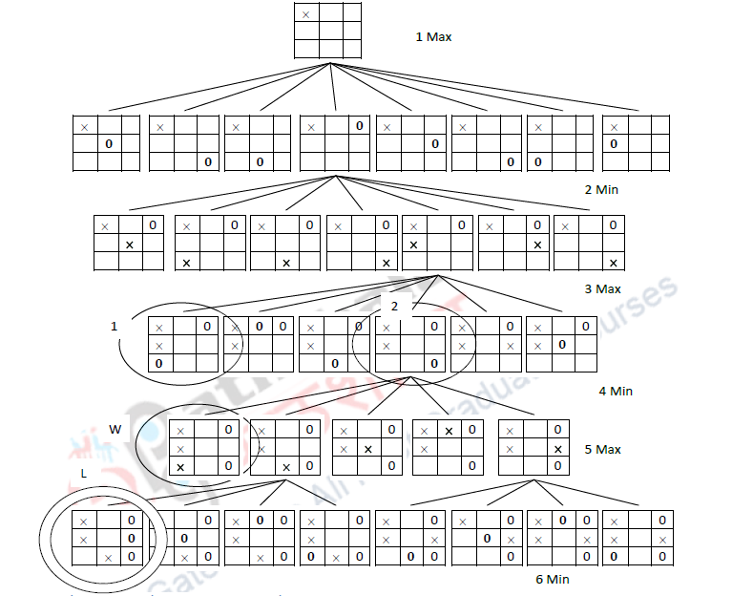
P

Slide 6

When the game begins, both the players take turn in marking one of the cells of the matrix.
When a player is able to mark three consecutive cells before other player, he is a winner.
Three consecutive cells can be marked in total 8 different ways; three columns, three rows and two diagonals.
Below figure shows eight different ways one can win.

Slide 7
For simplicity the opponent moves are not shown.
The aim of the player is to reach to any one of such states.
Another important aim of a player is to make sure that opponent cannot achieve similar state and win (so you lose).
In fact it is also possible to reach to a state where none of the players has three consecutive marks and none wins.
That is known as draw.
The game tree depicted in slide 5 is not completely drawn but still can convey the idea.
Total six plies of the game tree are drawn and each player has taken three moves each.
At each ply we have explored only one child for simplicity.

Slide 8
Other children can be explored in similar manner.
The first player marks his choice using cross (x) while the second player (the opponent) uses zero (0) to indicate his choice.
The first player takes a move at level 1,3,5 and so on while the opponent takes a move at level 2,4,6 and so on.
The moves taken by first player (who is under consideration right now) are Max moves while the moves taken by second player (the opponent) are Min moves.
Look at level 1, this is where the player starts his move from the left top corner.
In fact he has total 9 possible moves out of which he chooses one.

Slide 9
We have not shown other 8.
In the next level there are 8 possible choices for the opponent.
He chooses one which is shown in the figure.
Other 7 nodes are not explored.
In a real game tree all choices are explored.
Each node in this game tree is a 3 X 3 matrix.
This matrix represents the tic-tac-toe board.
Each level is numbered as well as indicated if Max or Min.
Suppose you are a player. You would like to win.
Thus you would like to reach to the state encircled in the figure in slide 5, named as W (win) written just next to it.

Slide 10
In fact if we draw complete game tree there are total 8 different possible states which we can mark as W as mentioned in figure in slide 6.
Similarly, the opponent wants to reach to state marked by double circle (where he has three consecutive 0s) and named as L.
He also has more than one such state but not always as many as the first player.
For example the case depicted in slide 5 where the first player has already occupied left top corner, three choices for the second player is simply not possible for winning.
Closely observe the content of the figure in next slide.

Slide 11

Three options indicated by 0 instead of 0 are not available as the left top corner is occupied by the first player and we cannot have three consecutive cells marked using that corner.
We would like to reach to the state mentioned as W in figure slide 5 (where we have three cross covering the leftmost column).

Slide 12
We would like to pick up each node in a way that we can reach to that node by the time 5th move is taken.
Let us assume that the game has reached to 3rd level
We would like to pick up move mentioned as 2 to reach to the state W.
Can we do that? We cannot.
It is the opponent’s move. He will have to decide that move.
If he is not a novice with the game, he won’t choose that move as he can understand that if he does so, you can win.
He, instead, would choose move 1, which will prevent you to win.
When there are contrasting goals at each layer, it is impossible to apply search methods that we have used in past.

Slide 13
We cannot optimize every move.
Thus however simple this game looks like, you need to devise some other algorithm for coding it as the conventional search algorithm that we have used so far does not really work.
What do we need to change here?
We want to build the search algorithm which works differently at alternate levels.
On odd levels(1,3,5.. ) etc, the algorithm should act like normal search algorithm and pick up the state which maximizes our chances of winning.
For all even levels (2, 4, 6…), we will have to remember that it is our opponents turn so we need to pick up the worst move for us (as opponent is likely to choose that).

Slide 14
Thus we will have to choose Max state at one level and Min state at another level.
Now you can see why they are called Min and Max levels.

Slide 15
Evaluation function
Since we cannot inspect the complete game tree and compute the minimax value, we have to resort to other means of selecting the move to make.
If we could have computed the minimax value, we would have selected the move that would have been known to be the best move.
Now instead, we have to look for methods with which we will select moves that appear to be the best.
This is done by using a function to evaluate the goodness of a state.
In game playing terminology, we call it the evaluation function, and it tells us how good a given position (state) is from the perspective of MAX.

Slide 16
The outcome of a game is a value from the set (-1, 0, 1).
The evaluation function, however, is usually applied to an intermediate node, and we are not in a position to choose a value from the set, since the game has not ended, and we cannot evaluate the full tree.
Instead, we define the range of the evaluation function as the real interval [-1, 1].
The extreme values —1 and 1 still represent wins for the two players.
But other values estimate how close to winning each side is.
For example, the value 0.5 says that MAX is better off than MIN, and 0.75 says that MAX is even more better off.

Slide 17
A value of —0.9 says that MIN is doing very well.
Note that the value zero says that both players are equally placed.
It does not say that the game has ended in a draw.
In practice, we extend the range to something like [-10000, 10000] which is more conducive to devise evaluation functions.
We will refer to it as [—Large, +Large].
Where do we get the values from? This is where the knowledge of an expert comes in.
Generally, the evaluation function is computed as a sum of values of different features, and we add or subtract values for each good feature or bad feature.

Slide 18
This kind of knowledge may be acquired from an expert, or one could devise experiments to learn from experience.
Typically, the evaluation function is split into different components.
In Chess, for example, one may count the material value and add to that the positional value.
Chess players are used to assigning values to the pieces in the range of 1 to 10.
Typically, pawns are valued at one point, knights and bishops about three points each, rooks about five points, and the queen about nine points.
The fighting value of the king in the end game is equivalent to about four points.

Slide 19
The material value of the king would be large, if it were counted, because its capture ends the game in a loss.
Chess programmers however choose numbers in a larger range, thus enabling them to add positional values also more precisely.
Thus, in the evaluation function of a program, a queen may be worth 900 points, a rook 500, a bishop 325, a knight 300 and a pawn 100.
The material balance on a given board position is arrived at by adding the value of all the pieces on our side, and subtracting the value of pieces on the opponent's side.
One may observe that the value of the evaluation function in the starting position is zero.
The positional part of the evaluation function looks at many aspects.

Slide 20
These are concerned with mobility, board control, development, pawn formations, piece combinations, king protection, etc.
The evaluation function of the program Deep Blue has about 8000 components (Campbell et al., 2002).
The value determined by a component of the evaluation function could have also been determined by searching further.
For example, if one ascribes a value to the existence of a fork pattern on a chessboard (see next figure), it says that a fork tilts the value in favour of the player by a certain amount.
If this was not part of the evaluation function, the advantage would have become evident after a few plies search.
In the example in the figure, the Red Knight attacks the White Queen and the White Rook simultaneously.

Slide 22
White can move only one of the pieces away, and in the next move the Red Knight could capture the other piece, gaining material advantage, even if the knight is captured in turn.
This estimate of material gain could be encoded as the value of the pattern.
The key thing is that this value is available from the given board position directly, without having to look ahead.
This also illustrates how knowledge can be used to trade off search.
One obvious way to play the game now would be to evaluate all the positions that result from the moves one can make, and choose the best one.
This would be called one-ply look-ahead and is depicted in next figure .

Slide 23
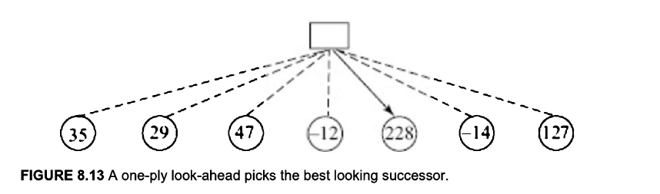

Slide 24
This would be fine if the evaluation function was very good.
While it has emerged that grandmasters do store tens of thousands of Chess schemata and evaluate them directly, it is difficult to devise an evaluation function that is good enough to play with one-ply look-ahead.
In practice, Chess programmers rely on a combination of evaluation and look-ahead.
While we cannot write programs to look ahead till the end of the game, we can still do so to look ahead a smaller distance.
Next figure below gives you a feel of the exploding search space with a game tree involving four choices per board position.

Slide 26
Look-ahead takes care of the combinatorial aspect of the game, like piece exchanges in Chess, which cannot be captured easily in a heuristic (evaluation) function, while the evaluation function provides a mechanism for evaluating the material and positional properties of nodes at the end of an incomplete look-ahead.
The amount of look-ahead would basically depend upon the resources available to the program.
The faster the machine, the more is the look-ahead possible in the same time.
The more the program looks ahead, the better it is likely to play.
Experts hypothesize that even with a simple evaluation function, a program that looks ahead fourteen to sixteen plies will play at a grandmaster level.

Slide 27
The extent of look-ahead is determined by the computing resources available.
Most commercial programs do an eight-or nine-ply search.
More sophisticated machines try and harness parallel computing with specialized hardware.
One does not have to do a fixed look-ahead rigidly.
We can write programs to explore critical regions deeper.
While playing competitive Chess, one is constrained by the clock.
One can then do a flexible amount of look-ahead, depending on the amount of time available.
The search component keeps searching deeper and deeper, and when the controlling program needs to play a move, it simply picks the best known move available.

